Slide 1


MOBILE APPLICATION FOR CATARACT DETECTION
Department of Information Technology
V R Siddhartha Engineering College
BIG DATA & DATA ANALYTICS
B.Tech in Information Technology
EPICS Project Review Presentation
Presented by
A.Charan (208W1A1268)
K.Mounav (208W1A1291)
P.Y.Sai Srinivas(208W1A12A4)
Under the guidance of
DR.T.Anuradha, Professor

Slide 2
Agenda
Problem Definition
Objectives
Literature Review & Summary
Data set & Software Requirements
Hardware Requirements
Architecture
Algorithm
References

Slide 3
Problem Statement
Every year In INDIA nearly 1.6 million people are getting effected by cataract
cataract has been reported to be responsible for 50-80% of the bilaterally blind in INDIA
But there are not enough Ophthalmologists for screening of cataract
There is only 1 Ophthalmologist for 250000 people in rural India
Screening millions of people with this ratio of available Ophthalmologists is difficult
we are developing an app that detects Cataract. This makes eye screening accessible to rural people

Slide 4
Objectives of the Project
The Main Objective is Identifying whether a person is suffering from cataract or not
The goal is to develop a mobile app that which can detect whether a person having cataract or not
Allowing user to upload or take new photos of eye to check for cataract

Slide 5
Literature Review
S.no | Paper | Methodology | Year | Algorithm Used | Result
1 | Detecting Cataract Using Smartphones | Has developed a classifier model based on Support Vector Machine (SVM). They have used luminance transformation and pixel brightness Algorithm to extract lens images features | 2021 | Support Vector Machines (SVM) | A mobile app that can detect Cataract
2 | CataractNet: An Automated Cataract Detection System Using Deep Learning for Fundus Images | Has developed a Deep neural system called cataractNet, Which is pretrained Convolution neural network model, They have taken nearly 1130 images from the ACHIKO-1 fundus image data set they got an accuracy of nearly 97% | 2021 | Convolutional Neural Network (CNN) models. | A Deep Neural Network System called CataractNet

Slide 6
Literature Review
S.no | Paper | Methodology | Year | Algorithm | Result
3 | Unified Diagnosis Framework for Automated Nuclear Cataract Grading Based on Smartphone Slit-Lamp Images | has developed a classifier model using the Support vector machine (SVM) They trained the model using 819 anterior ocular images captured using a Smartphone based slit light They collected the images from Marked slit lamp picture project (MSLPP) created by the HE Eye specialist Hospital(HESH) China | 2020 | Support Vector Machines | A model that can predict the presence of cataract from slit lamp images
4 | Cataract Detection using Digital Image Processing | has Used Hough transforms and contour detection to determine the shape and the degree of the cataract | 2019 | Hough Transfrom And Contour Detection | A model that can predict the level of catract

Slide 7
Summary
MASUM SHAH JUNAYED has developed a system that can detect cataract but they didn’t created any app or any web application so it is not accessible for every one
SHENMING has developed a system that can predict cataract based on slit lamp images but getting slit lamp images requires high end equipment
So we are trying to create a model that can predict cataract by images that are taken from a normal smart phone

Slide 8
Datasets
ODIR(Ocular Disease Intelligent Recognition) provided by shanghai medical university contains 632 fundus images of normal eye and 448 images of cataract
Link1:https://www.kaggle.com/datasets/andrewmvd/ocular-disease-recognition-odir5k
IDRID(Indian Diabetic Retinopathy Image Dataset) contains nearly 800 images of eye fundus of cataract and normal eye
Link2:https://ieee-dataport.org/open-access/indian-diabetic-retinopathy-image-dataset-idrid
We also went to nearby Hospitals to collect the data and they promised us to give the data

Slide 9
Software Requirements
Opencv ,kereas, Tensorflow libraries
Python and java Programming languages
Android studio and visual Studio code and jupyter note book

Slide 10
Hardware Requirements
Android or IOS Operating system
Configuration:1GB or more Ram
Smartphone with more than 16MP camera

Slide 11
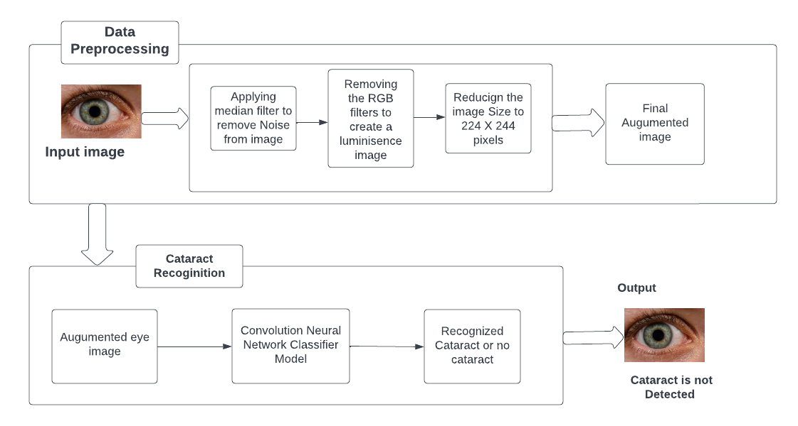
Architecture Diagram
Output
No cataract
The complete process flow for cataract detection

Slide 12
ALGORITHM
Convolutional Neural Network or CNN is a type of artificial neural network, which is widely used for image/object recognition and classification. Deep Learning thus recognizes objects in an image by using a CNN. CNNs are playing a major role in diverse tasks/functions like image processing problems, computer vision tasks like localization and segmentation, video analysis, to recognize obstacles in self-driving cars, as well as speech recognition in natural language processing.
Median filter is one of the well-known order-statistic filters due to its good performance for some specific noise types such as “Gaussian,” “random,” and “salt and pepper” noises

Slide 13
Steps:
Importing libraries that are best fit for image processing and deep learning algorithms like Opencv,Kereas,Tensorflow,Numpy etc.
Performing the data preprocessing by removing the removing the noise from image using median filter and reducing the image size to 224X224 pixels
Using Trained cnn classifier model for final cataract recoginition

Slide 14
References
[1]Askarian B, Ho P, Chong JW. Detecting cataract using smartphones. IEEE Journal of Translational Engineering in Health and Medicine. 2021 Apr 20;9:1-0.
[2] Junayed MS, Islam MB, Sadeghzadeh A, Rahman S. CataractNet: An automated cataract detection system using deep learning for fundus images. IEEE Access. 2021 Sep 15;9:128799-808.
[3] Hu S, Wang X, Wu H, Luan X, Qi P, Lin Y, He X, He W. Unified diagnosis framework for automated nuclear cataract grading based on smartphone slit-lamp images. IEEE Access. 2020 Sep 21;8:174169-78
[4] Jindal I, Gupta P, Goyal A. Cataract detection using digital image processing. In2019 Global Conference for Advancement in Technology (GCAT) 2019 Oct 18 (pp. 1-4). IEEE.

Slide 15

Thank you

